Slide 1
Project Assignment: COMP4621
Build a file sharing chatroom application
Spring 2025
TA: Lunxi CAO
E-mail: lcaoar@connect.ust.hk

Slide 2
Outline
Review of concurrent client-server
Multi-thread method (pthreads)
Programming project introduction

Slide 3
Review
We have learned multiple technique for concurrency:
fork(): Creating multiple processes. Fork a new process for each connection.
settimeout: Setting a timeout for each connection so that the process wouldn’t be occupied by a single connection.
poll()/select(): Using an overall mechanism to manage all blocking operations (e.g., recv(), listen()).
Today, we introduce another technique:
4. multi-threading: a light-weight fork().

Slide 4
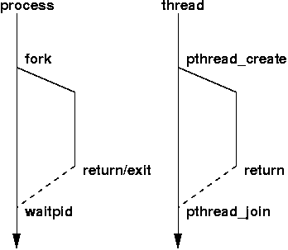
Pthreads
Pthreads is a set of threading interfaces developed by IEEE, responsible for specifying the Portable Operating System Interface for UNIX (POSIX).
Pthreads specifies APIs to handle most of the behavior required by threads, including creating and terminating threads, waiting for threads to complete, and managing interactions between threads.
In the Linux/MacOS environments, you can consult the man pages for pthread functions such as pthread_create().
Notes:
We have seen before the fork system call that allowed us to create a copy of the process to run concurrent clients, we have also seen that forking new processes can be costly in terms of time and resources.
Thread is another concept of thin processes that allow for concurrency without the heavy workload introduced by forking fully-fledged processes. Threads belong to a process or process group in Linux and can be considered as lightweight processes that share resources. Pthread is a standard library that allows us to create and schedule threads in UNIX flavors.

Slide 5
Pthreads
int pthread_create (
pthread_t* thread,
const pthread_attr_t* attr,
void* (*start_routine ) ( void *),
void* arg_p) ;
The function that the thread is to run.
We won’t use and just set NULL.
Pointer to the argument that should
be passed to the function start_routine.
Allocate thread before calling.
Return value: on success, pthread_create() returns 0; on error, it returns an error number.

Slide 6
Pthreads
#include <pthread.h>
int pthread_join(pthread_t thread , void ** retval);
Description:
wait for the thread specified by thread to end in a blocking manner. When the function returns, the resources of the waiting thread are reclaimed. If the thread has ended, the function returns immediately.
Arguments:
thread: the thread identifier, which identifies a unique thread
retval: a user-defined pointer used to store the return value of the waited thread
Return value: On success, pthread_join() returns 0; on error, it returns an error number.

Slide 7
Pthreads
#include <pthread.h>
void pthread_exit(void *retval);
Description:
terminate the calling thread and returns a value via retval
Arguments:
retval: a pointer of void* type can point to any type of data, and the data it points to will be used as the return value when the thread exits
Return value: This function does not return to the caller.
You can find a lot more details about Pthread in this short tutorial on the web

Slide 8
Programming project description
Programming assignment object
Build a system allowing both chat and file sharing services.
For file sharing, each client queries the file information from the server by UDP and gets the file by peer-to-peer TCP connection with another client.
Server
Client-server based on UDP
…
client1
client2
…
clientn
P2p connection based on TCP

Slide 9
File sharing
Server
ip port: bitmap
ip port: bitmap
…
Client-server based on UDP
…
client1
client2
…
clientn
P2p connection based on TCP
We assume at most 32 files (00.txt … 31.txt). The server maintains an unsigned integer variable for each client, in which each bit indicates whether this client has this file. For example, client1 has 01.txt and 31.txt, then the bitmap corresponds to this client is “0100 0000 0000 0000 0000 0000 0000 0001” in binary format.
After the client starts, it should tell the server what files it has. Then the server will store this information for this client. Whenever there is a client that wants to query for a specific file, it sends a query message to the server and the server returns the addresses of clients that have this file.
Then the client selects one of these addresses and request to download the file from this peer address.

Slide 10
File sharing
Server
Client-server based on UDP
…
client1
client2
…
clientn
P2p connection based on TCP
The communication between the client and the server uses rdt3.0 on UDP, i.e., there is no permanent connection between the clients and the directory server for file sharing (but a TCP connection between each client and the server for chat exists, which is established after registration and closed when the client exits.)
The connection between clients are based on TCP. The clients create a background thread to work as a server to provide file download services to other clients. Additionally, this server uses poll() to achieve concurrency among concurrent clients.

Slide 11
Programming project description
Programming assignment object
Build a system allowing both chat and file sharing services.
For chat, each client connects to the server by TCP. The server takes responsibility for forwarding received message by TCP to other users or the specified user.
Server
Connection based on TCP
…
client1
client2
…
clientn

Slide 12
Chat
Server
Connection based on TCP
…
client1
client2
…
clientn
A TCP connection between each client and the server for chat is established after registration and closed when the client exits.
The server creates a thread dealing with chat and use poll() to achieve concurrency among concurrent clients.
Each client creates a thread receiving the messages from the server.

Slide 13
Commands about services
REGISTER is sent to the server to register IP, port, name and required services. At least one of file sharing service and chat service should be enabled. If enabling file sharing, the client will tell the server what files it has. If enabling chat, the server will send a welcome information to other users in chat by TCP.
Require ACK. To simplify the implementation and testing, we assume all clients from the same IP 127.0.0.1.
Client1
Server
SEQ
SPACE
“REGISTER”
SPACE
IP
Port
Name
Flag of services
REGISTER
1
1
8
1
4
2
20
1
ACK
SEQ
Return Value
“ACK”
1
1
3

Slide 14
Commands about services
UPDATE is sent to the server to update the required services. At least one of file sharing service and chat service should be enabled. If enabling file sharing, the client will tell the server what files it has. If enabling or disabling chat, the server will send a welcome or goodbye information to other users in chat by TCP.
Require ACK.
Client1
Server
SEQ
SPACE
“UPDATE”
SPACE
IP
Port
bitmap
Flag of services
UPDATE
1
1
6
1
4
2
4
1
ACK
SEQ
SPACE
“ACK”
1
1
3

Slide 15
Commands about file sharing
QUERY is sent to the server to query the accessible p2p clients for a file.
RESPONSE is sent to the client to provide available IP and port.
FINISH is sent to the client to indicate all IP and port are returned.
Client1
Server
QUERY
SEQ
SPACE
“QUERY”
SPACE
“xx.txt”
1
1
6
1
6
ACK
SEQ
SPACE
“RESPONSE”
SPACE
IP
Port
RETURN
1
1
8
1
4
2
SEQ
SPACE
“FINISH”
ACK
1
1
6
…
FINISH

Slide 16
Commands about file sharing
GET is sent to the p2p client to get the above queried file from one p2p client.
Client1
Client2
TCP Handshake
“xx.txt”
6
“xx.txt”
File length
File length
4
File transfer
File transfer
Wavehand
The file content, any reasonable length.
Note that the file transfer is based on TCP.

Slide 17
Commands about chat
@ALL: is sent to server to broadcast a message to other clients in chat.
Client
Server
Any other client in chat
@ALL:message
‘xx’ @ all: message
The TCP connection between each client and server is established after registration and closed when the client exits.

Slide 18
Commands about chat
WHO is sent to server to get a name list of other clients which enable chat service.
Client
Server
WHO
Users in chat: ‘a’ ‘b’ ‘c’

Slide 19
Commands about chat
@ is sent to server to forward a message to the specified client with the name.
Client ‘aa’
Server
The specified client ‘bb’
@’bb’message
‘aa’ @ you: message

Slide 20
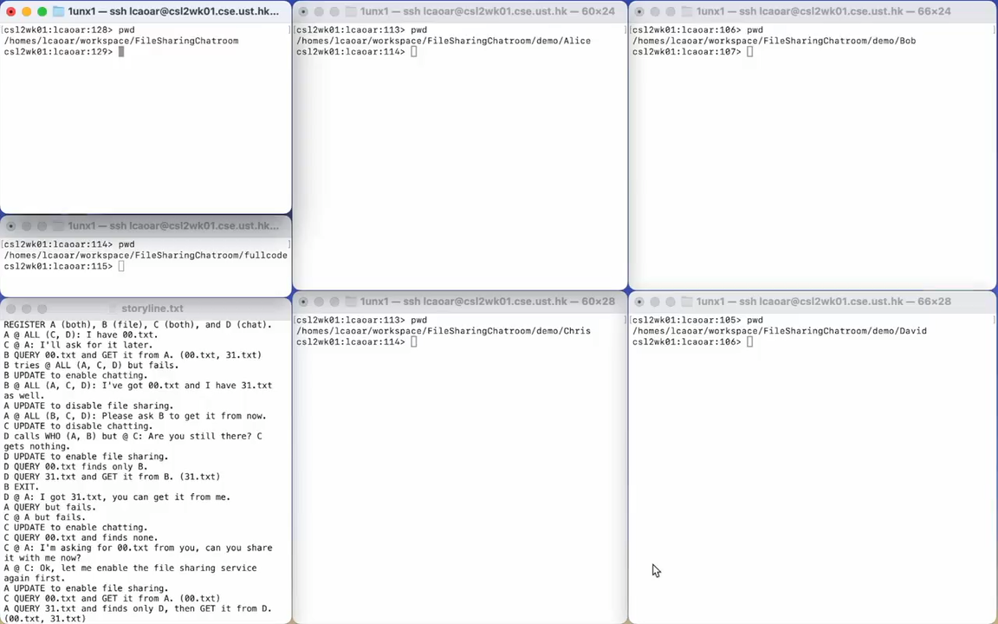
A demo

Slide 21
Programming project description
Requirements:
Programming must be in C.
You must implement rdt3.0 based on UDP to deal with commands about services and file sharing. For chat, the three commands should be implemented with TCP.
The server should be able to provide services to multiple clients simultaneously. That means it should provide a concurrent rdt3.0 based on UDP for file sharing, and concurrency on TCP using poll() for chat.
You must implement a p2p server and p2p client in “client.c”. Start the p2p server using the multi-thread function when the client get started.
The p2p server and the chat server must be based on poll() to enable concurrency.
The submission contains “client.c”, “server.c”, and a report “<your student id>.pdf”.
Your code is only required to process valid commands.

Slide 22
Skeletons of codes
Skeletons for the client and the server are provided for you in the ./skeleton/ folder.
/***********************************************
* Refer to REGISTER implementation above and
* the UPDATE protocol description. Dealing with
* UPDATE packet
* START YOUR CODE HERE
**********************************************/
YOUR CODE
/***********************************************
* END OF YOUR CODE
**********************************************/
Notes:
I will share the screen to show the skeletons of codes.

Slide 23
Grading scheme
The three chat commands work well. We will manually test your code with valid commands in the demo storyline, including REGISTER, UPDATE, @ALL:, WHO, and @. The other file sharing commands are excluded. So, you can try yourself following the demo storyline. (12% for @ALL:, 8% for WHO, and 12% for @)
Your code passes the provided test1 for the simplest scenario. This test case will test your code with two clients without packet loss and without latency. Both these two clients connect to the server one by one, and one client downloads a file from another client. (6%)
Your code passes the provided test2 for concurrency of the server. This test case is like the above one. Except that these two clients connect to the server at the same time. (6%)
Your code passes the provided test3 for multi-threading of p2p client and server. There are three clients start one by one. Client2 downloads a file from client1 and client3 downloads a file from client2 at the same time. And they are required to finish the transfer within 10s. (6% + another similar case for 6%)
Your code passes the provided test4 for packet losses. We will test your server code with a modified client, which will drop some ACKs for RETURN messages. (6% + another similar case for 6%)
Your code passes the provided test5 for packet losses. We will test your client code with a modified server, which will drop some ACKs for REGISTER/UPDATE/QUERY messages. (6% + another similar case for 6%)
A report for this programming project. (20%)

Slide 24
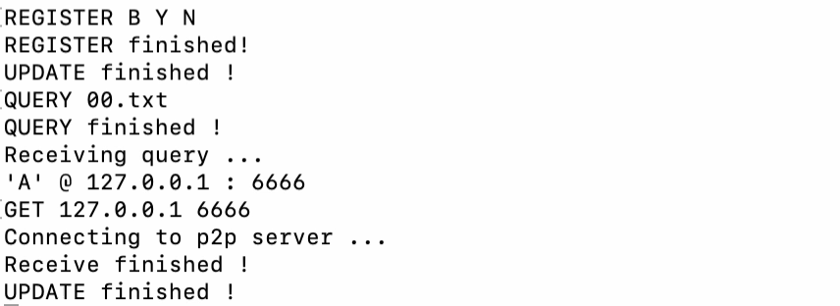
Bonus
After execute QUERY, return the IP and port number with a sequence number. When you execute GET, you can specify the sequence number instead of the full IP and port number.
If you finish this bonus task, please indicate in your report apparently. Upon successful verification, you will receive an additional 10% grade.

Slide 25
Testing your code yourself
All the provided code is tested on Lab2 machine. How to login? Refer to the first tutorial.
Chat
We will manually test your code with valid commands in the demo storyline, including REGISTER, UPDATE, @ALL:, WHO, and @. The other file sharing commands are excluded. So, you can try yourself following the demo storyline.
File sharing
If you want to test your code with test case 1:
Copy your code “client.c” and “server.c” to test1
$ cd test1
$ bash test.sh
Similar for test case 2/3/4/5
If your code pass the test case, it will print a “Succeed”. Otherwise, “Fail”.
The “test.sh” script is very simple, it just compiles and run your code. You can also test your code manually.
Note that I may use different hidden test cases (e.g., different txt file name, larger txt file size) when evaluating. But do not worry, the basic operations are the same. If your code works for the provided test case, the hidden test cases may work too.
Reminder, if all of you use the same machine as csl2wk01, you may conflict with each other.

Slide 26
Summary
We review the concurrency technique.
We learn how to use Pthread library to enable simultaneous sending and writing for the client.
The above two things are essential in our programming project.

Slide 27
Q&A
Now you have 20 minutes to ask questions about the programming project.

